Slide 1

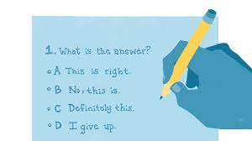



Guessing factors
Opponent
Feedback

Slide 2




